Slide 1
#1
File I/O
Open the attached file ‘article.txt’ with the predefined I/O .
Refer to https://www.w3schools.com/python/python_file_open.asp
Print out the article.
Keep in mind that “It is a good practice to always close the file when you are done with it.”

Slide 2
#2-1
Article analysis
Open ‘article.txt’, and count the number of words used in the article.
E.g.,
Notes
Must use python ‘Dictionary’
Do not use str.count() in python
Ignore comma, punctuation mark, and quotes.
E.g., “yes, I am.” -> yes I am
Tip: str.replace(.)
Do not tell small and big letters
E.g., You == you
What are you doing doing how are doing do you wanna doing
What: 1 Are: 2 Doing: 4 How: 1 You: 2 Do: 1 Wanna: 1 Total= 12

Slide 3
#2-2
Article analysis
Open ‘article.txt’, and count the number of each al used in the article.
E.g.,
Notes
Must use ‘List of List’
Do not use str.count() in python
Tell small and big letters
E.g., You != you
1. Sort the result in alphabetical order. (use your own sorting function)
2. Then, sort the numbers in ascending order. (use your own sorting function)
E.g., a: 5, b: 0 -> b: 0, a: 5
What are you doing doing how are doing do you wanna doing
a: 5 b: 0 … w: 2 … W: 1

Slide 4
#3-1
Image analysis
Open a gray image ‘carry.jpg’ using imread function in a module imageio
imageio installation: https://imageio.readthedocs.io/en/stable/installation.html
Read image:
Gray image is a kind of 2-D matrix
img = imageio.imread(“carry.jpg”)# read an image
You can check the dim with:
img.shape
Should return (675, 1200)
You can read pixel value at a pixel location (x,y)
img[y][x]
Should be an integer value between [0, 255]
Notes
Must use Dictionary
Do not use str.count() in python
Tell small and big letters
E.g., You != you
1. Sort the result in alphabetical order. (use your own sorting function)
2. Then, sort the numbers in ascending order. (use your own sorting function)
E.g., a: 5, b: 0 -> b: 0, a: 5

Slide 5
#3-2
Image analysis
Image statistics
Calculate the mean value of the given image with double for loops.
Calculate the variance of the pixel values.
Find the maximum, minimum, and median pixel values.
Use your own algorithms.
How many operations are carried out in your algorithms?

Slide 6
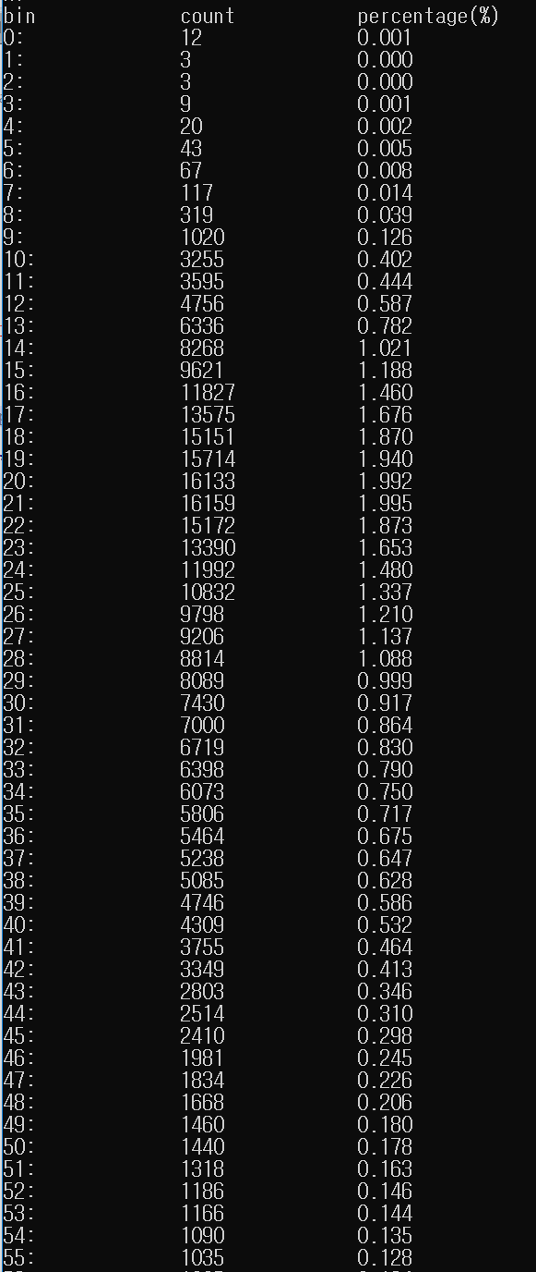
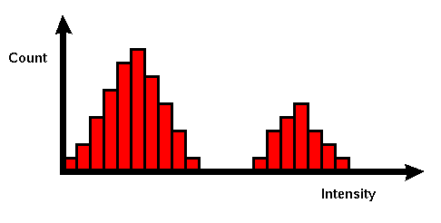
#3-3
Image analysis
Histogram
This histogram is a graph showing the number of pixels in an image at each different intensity value found in that image.
For an 8-bit grayscale image there are 256 different possible intensities [0, 255], and so the histogram will graphically display 256 numbers showing the distribution of pixels amongst those grayscale values.
Calculate the histogram from the given image “carry.jpg” and display.
should have 256 bins (i.e., 0-255).
‘percentage’ = 100*bin/(M*N)
where M and N denote height and width of the image, and thus M*N is total number of pixels.
Calculate sum of ‘percentage’ values over 256 bins.
Desired output

Slide 7
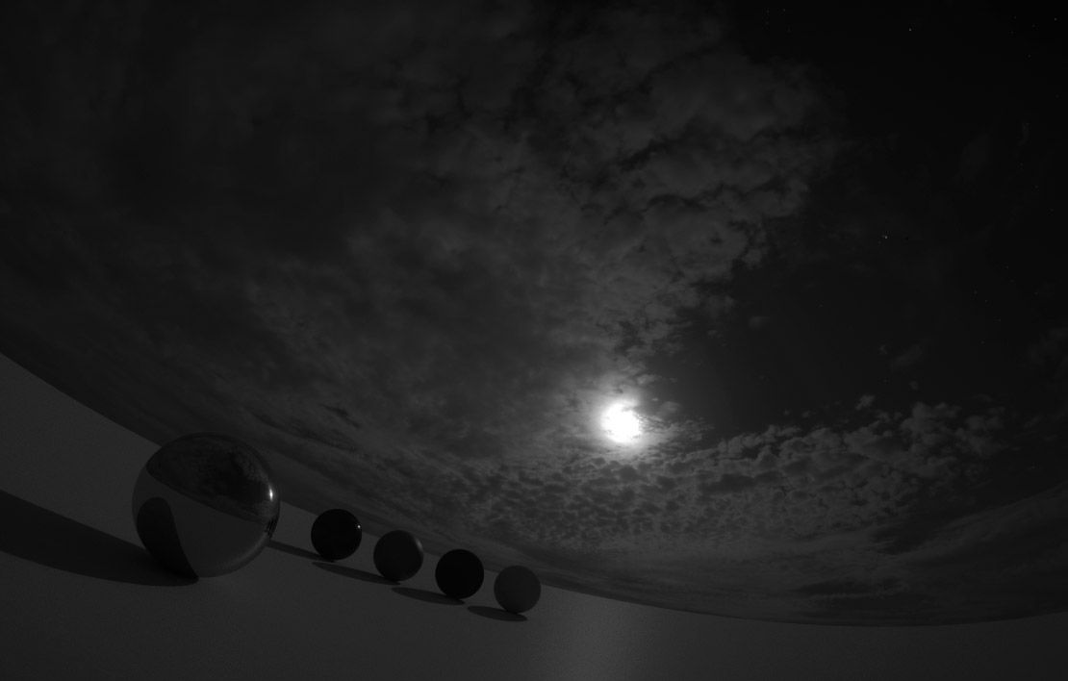
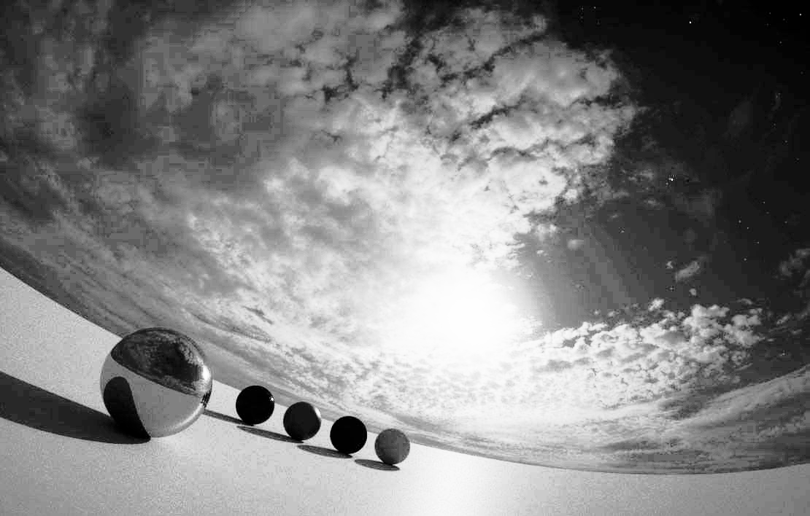
File I/O
Image analysis
Implement histogram equalization algorithm.
The algorithms is described in the attached pdf file.
Use ‘HDR.jpg’ image as input.
Save the modified image using imageio.imwrite() function.
Compare two histograms. One from the original image and the other one from the modified image. Can you see why this algorithm is called histogram equalization?
E.g.,

